Slide 1
Predictive Analytics PGDM-II: Term IV (2019-21) Multivariate GARCH Models
Kakali Kanjilal
Professor, OM & QT
IMI New Delhi

Slide 2
Introduction
Why study multivariate models
The models:
BEKK
CCC
DCC
Conditional correlation forecasts
Results
Interpretation and Conclusion

Slide 3
Motivation
It is widely accepted that financial volatilities move together over time across markets and assets. Recognising this feature through a multivariate modelling feature lead to more relevant empirical models.

Slide 4
Model Setup
We are considering the vector of returns, which has k elements. The conditional mean of given is and the conditional variance is .
Multivariate modelling is concerned with capturing the movements in

Slide 5
Problems with multivariate modelling
Parsimony
Models for time-varying covariance matrices tend to grow very quickly with the number of variables bring considered, it is important to control the number of free parameters.
Positive Definiteness
Imposing positive definiteness on some models lead to non-linear constraints on the parameters of the models which can be difficult to impose practically.

Slide 6
The Models
THE BEKK MODEL (Engle and Kroner 1995)
Where:
A and B are left unrestricted
No. of parameters:
P = 5k²/2 + k/2 = O(k²)
Ensures positive definiteness for any set of parameters and so no restrictions need to be placed on the parameter estimates.
For models with k<5 this model is probably the most flexible practical model available.

Slide 7
The Models
THE CCC MODEL (Bollerslev 1990)
Bollerslev proposed assuming that the time variation we observe in conditional covariances is driven entirely by time variation.
Where:

Slide 8
No. of parameters:
P = 3k + k(k - 1)/2 = O(k²)
The parameters can be estimated in stages, therefore making this a very easy model to estimate.
Model is parsimonious and ensures definiteness.
Some empirical evidence against the assumption that conditional correlations are constant

Slide 9
The Models
THE DCC MODEL (Engle 2002)
An extension to the Bollerslev model; a dynamic conditional correlation model. Similar decomposition:
Does not assume is constant.

Slide 10
No. of parameters:
P = 3k + 2 + k(k - 1)/2 = O(k²)
This model too can be estimated in stages: the univariate GARCH models in the first stage, then the conditional correlation matrix in the second stage. parameters can be estimated in stages, therefore making this a very easy model to estimate.
Model is parsimonious and ensures definiteness.
It can be applied to very high dimension systems of variablesSome empirical evidence against the assumption that conditional correlations are constant

Slide 11
The Models
Other models:
The vech model (Bollerslev et al 1988)
Too many parameters
No. of parameters: P = k⁴/2 + k³ + k² + k/2 = O(k⁴)
The factor GARCH model (Engle et al 1990)
Poor performance on low and negative correlations
No. of parameters: P = k(k - 1)/2 + 3m = O(k²)

Slide 12
Looking at Data
AMR - American Airlines (Transportation)
BP - British Petroleum (Energy - Oil)
MO - Philip Morris / Altria (Tobacco)
MSFT - Microsoft (Technology)
XOM - Exxon Mobil (Energy - Oil)
Largest companies in their sectors
Sufficient liquidity and therefore lower noise
1993-2003 daily returns
Actual correlations (---) calculated for every 6 month period

Slide 13
Pairs
AMR and XOM (transportation and oil)
‘Opposites’ should have negative correlation
BP and XOM (two of the largest oil companies)
Similar, should have positive correlation
MO and MSFT (tobacco and technology)
Unrelated, should have zero (?) correlation
Correlation should increase with time as markets globalize
Do market bubbles/crashes affect correlation?

Slide 14
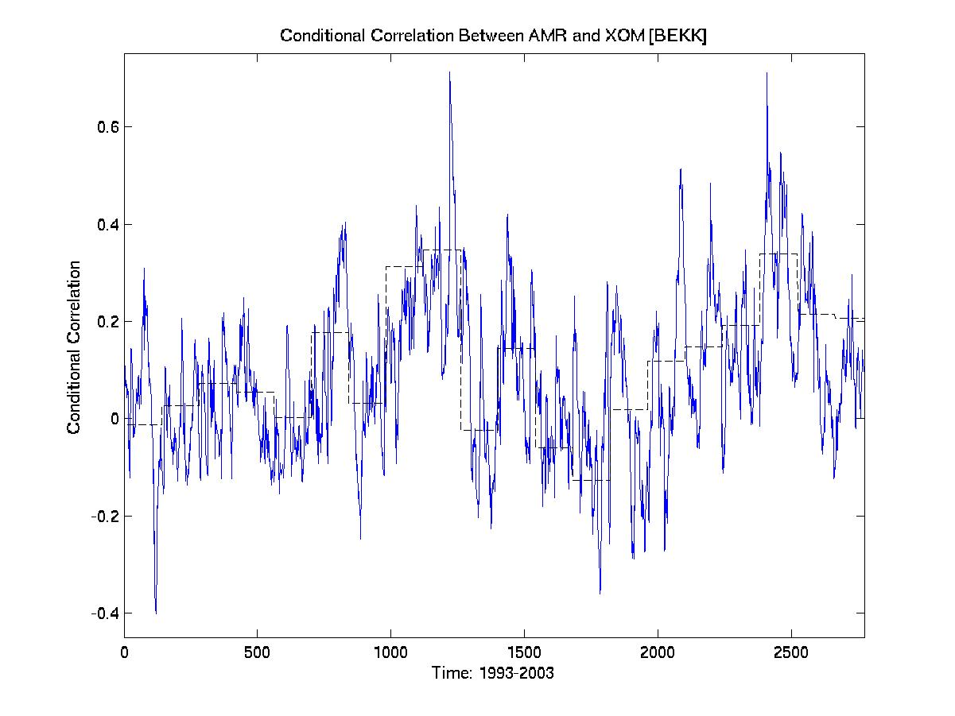

Slide 15
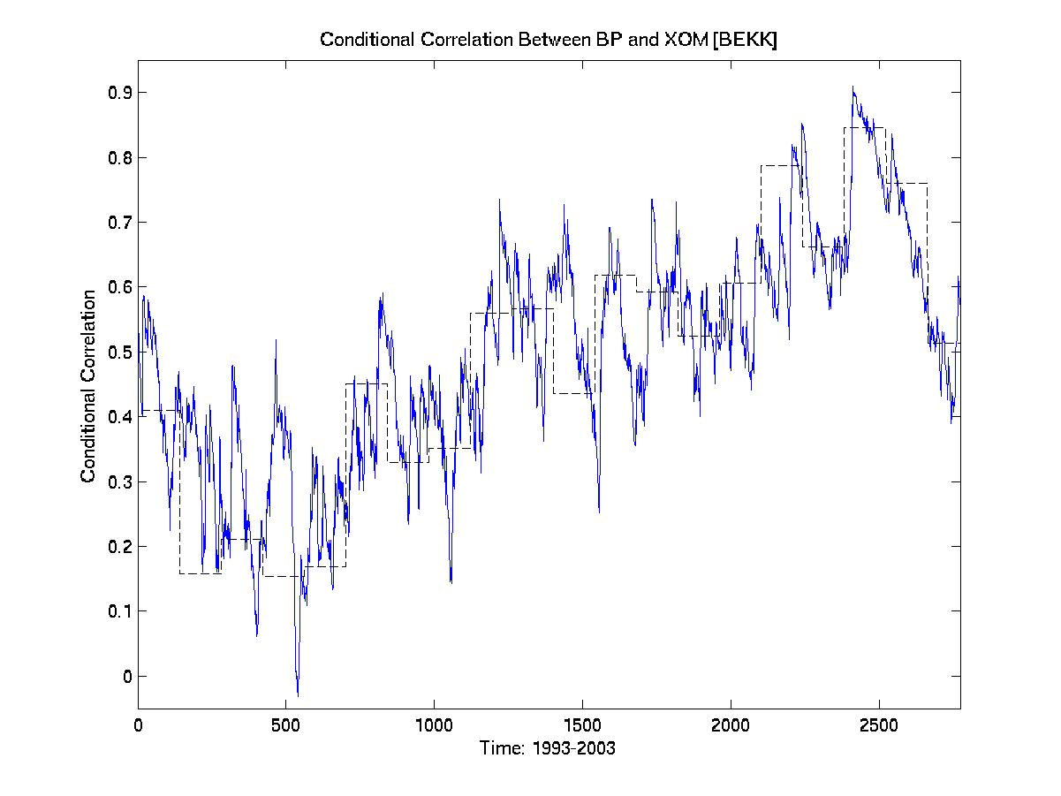

Slide 16
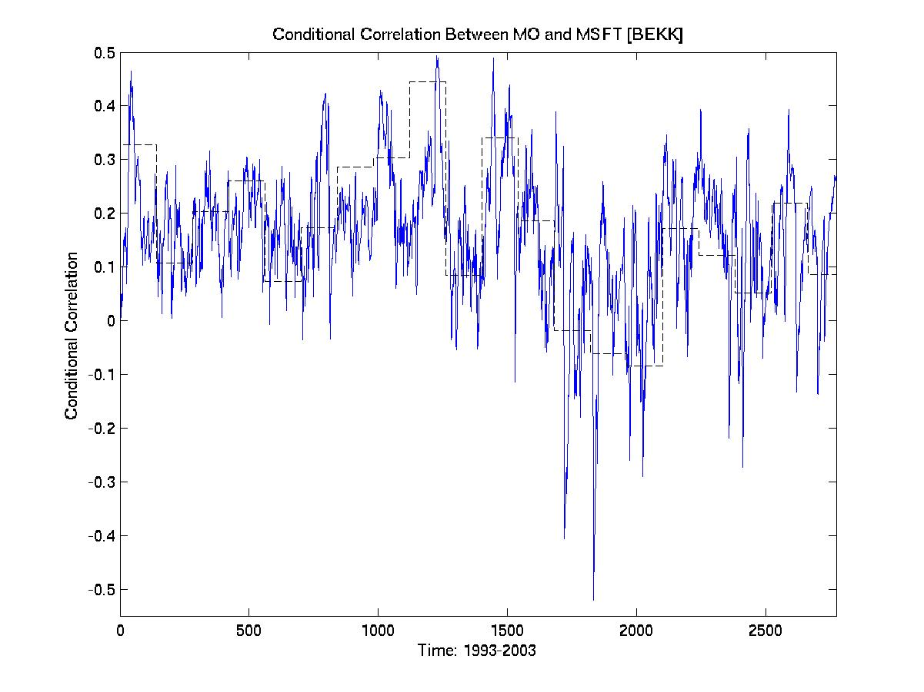

Slide 17
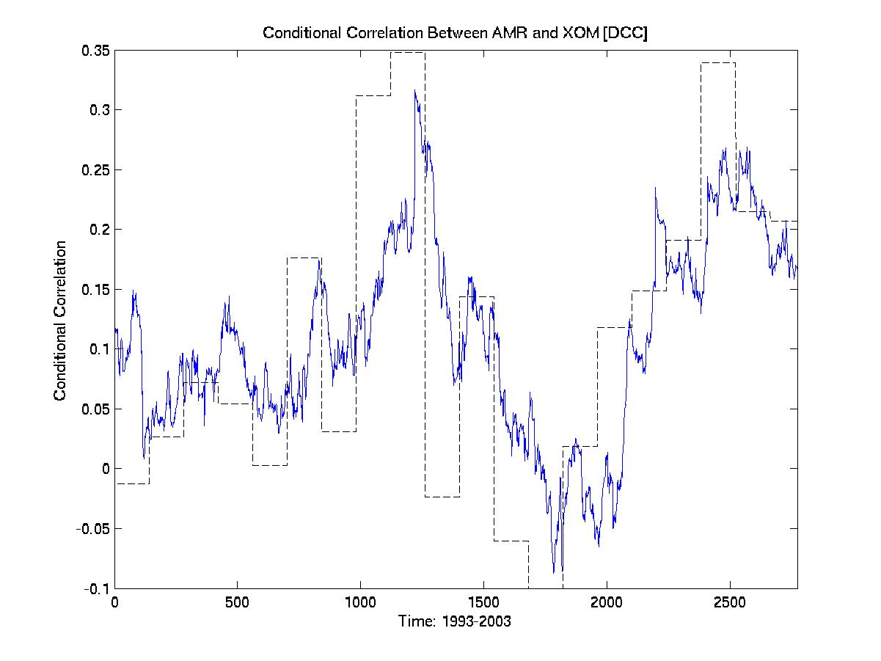

Slide 18
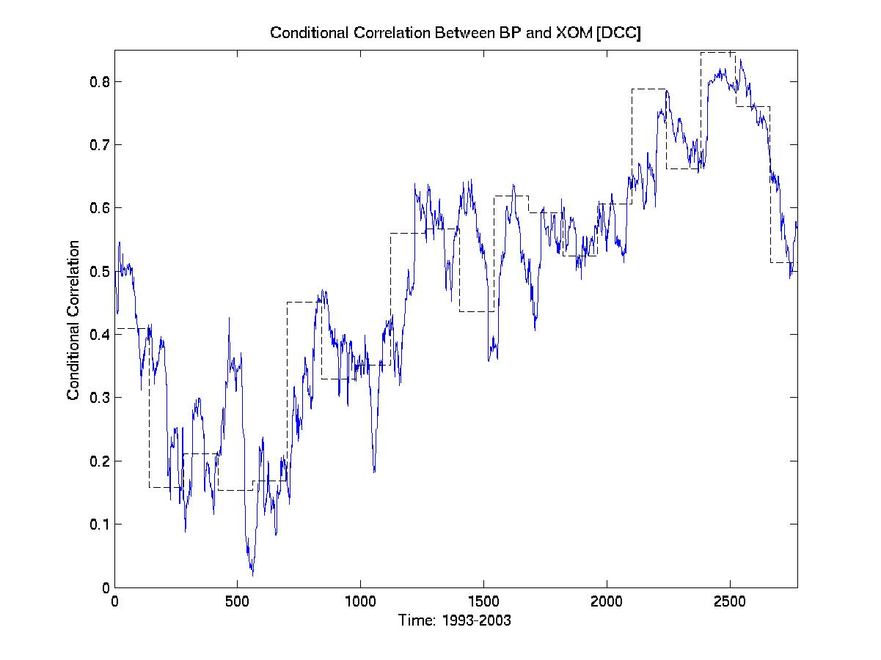

Slide 19
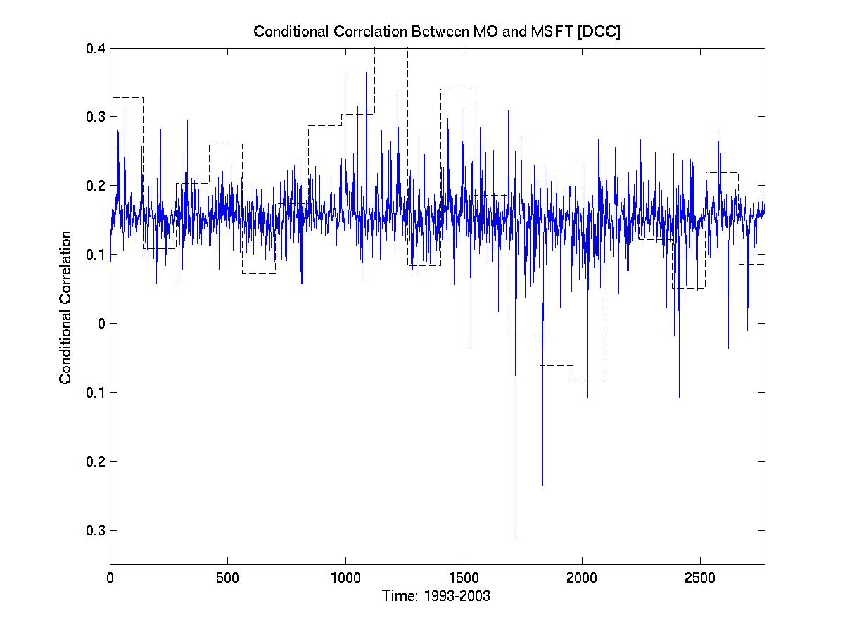

Slide 20
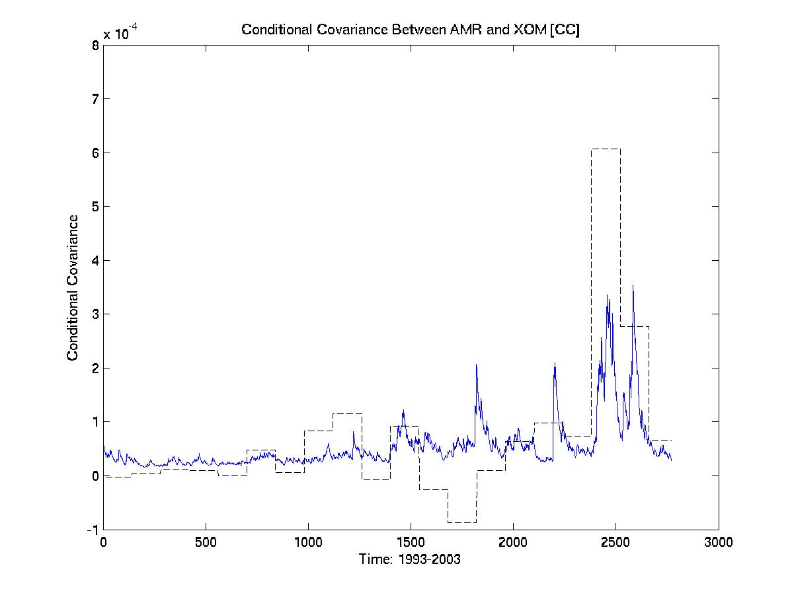

Slide 21
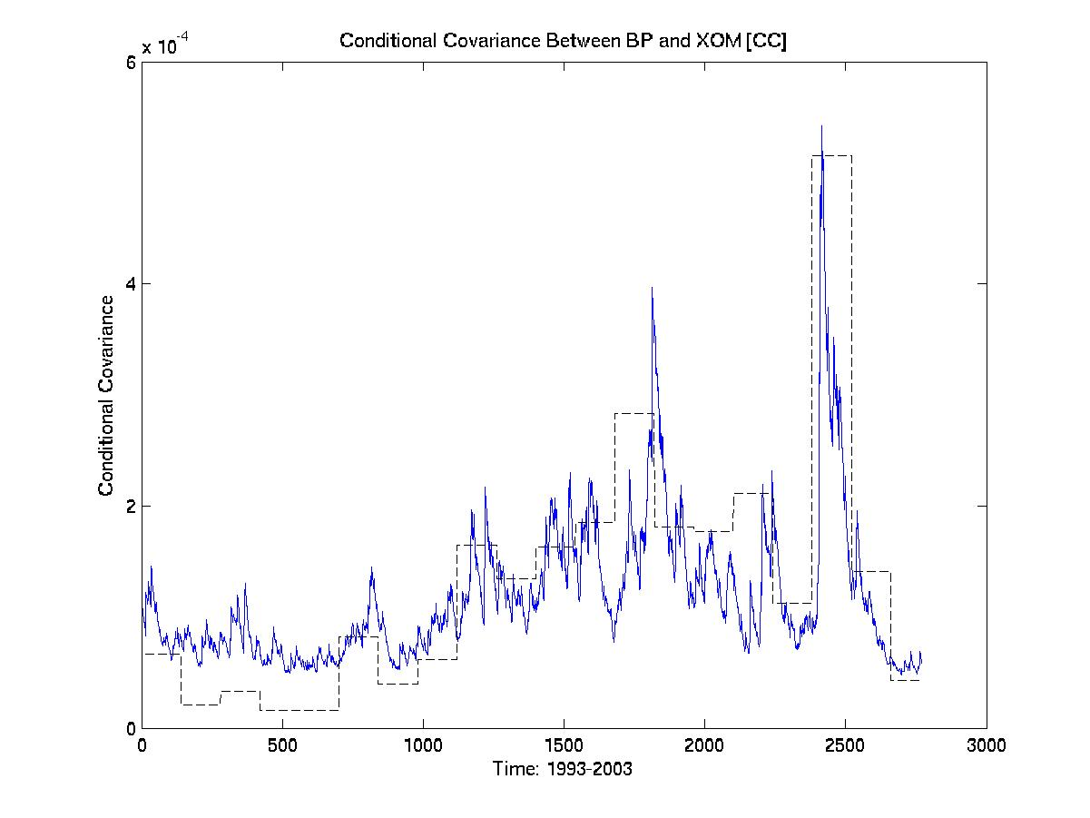

Slide 22
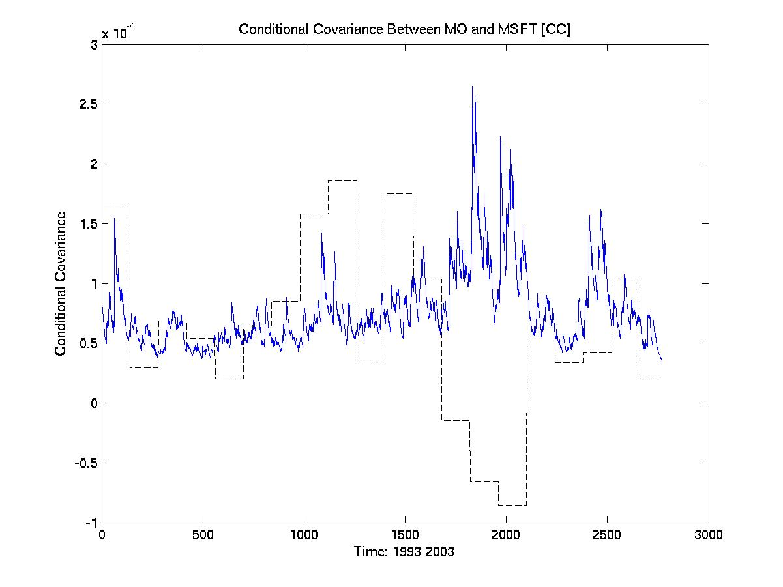

Slide 23
Comparison
Note: CC produces constant correlations, so covariances compared instead
BEKK produces by far the best results, with predicted correlations following actual correlations very closely for different stock types
DCC performs well for mainly positive, significantly oscillating correlations (poorly for MO and MSFT), but lags actual correlations more than the BEKK
CC (in covariances) does not handle negatives, and generally performs worse than the DCC for the same running time

Slide 24
Set of 3 stocks
AMR, MO, and MSFT
Transportation, Tobacco, and Technology
Predictions should improve

Slide 25
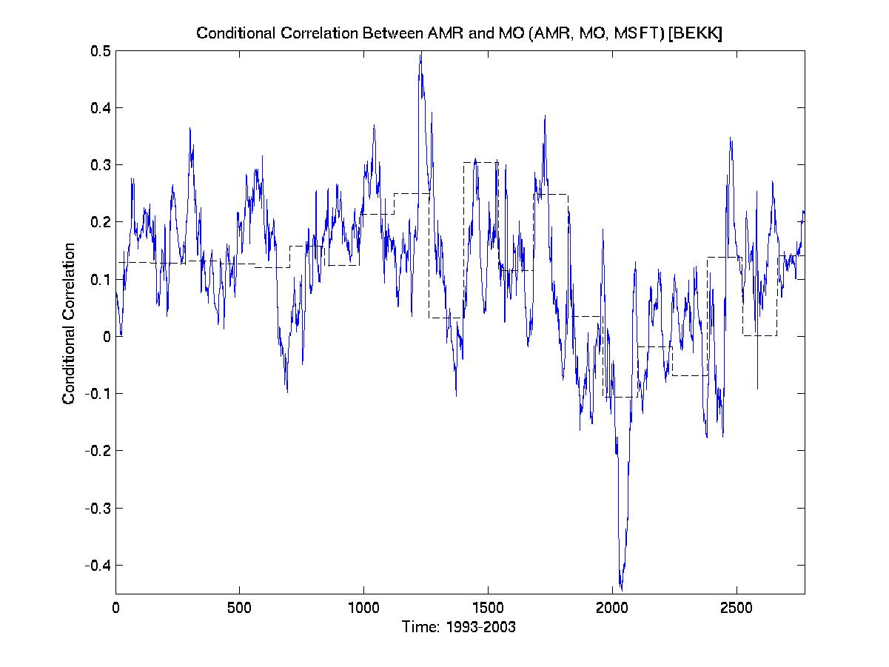
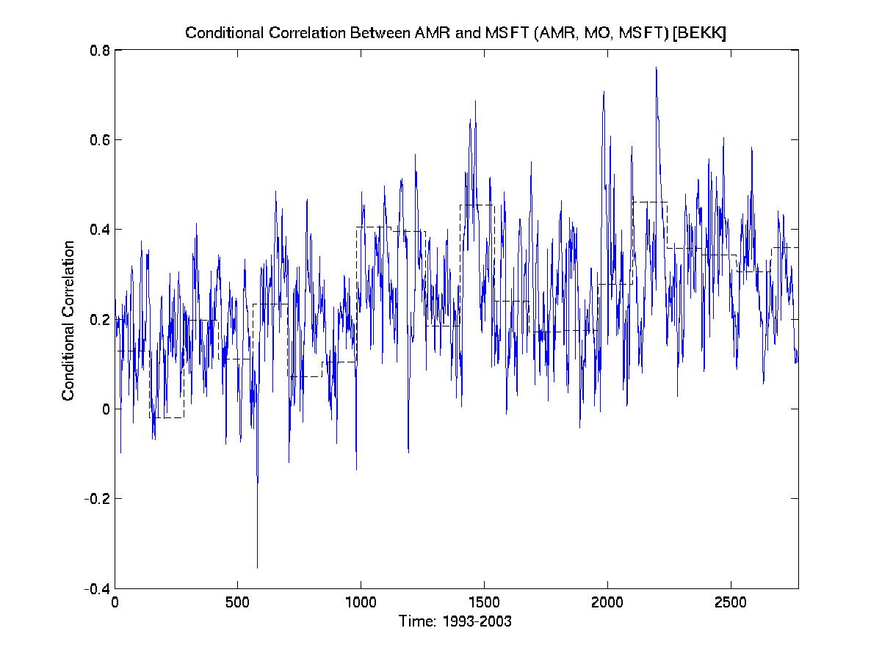
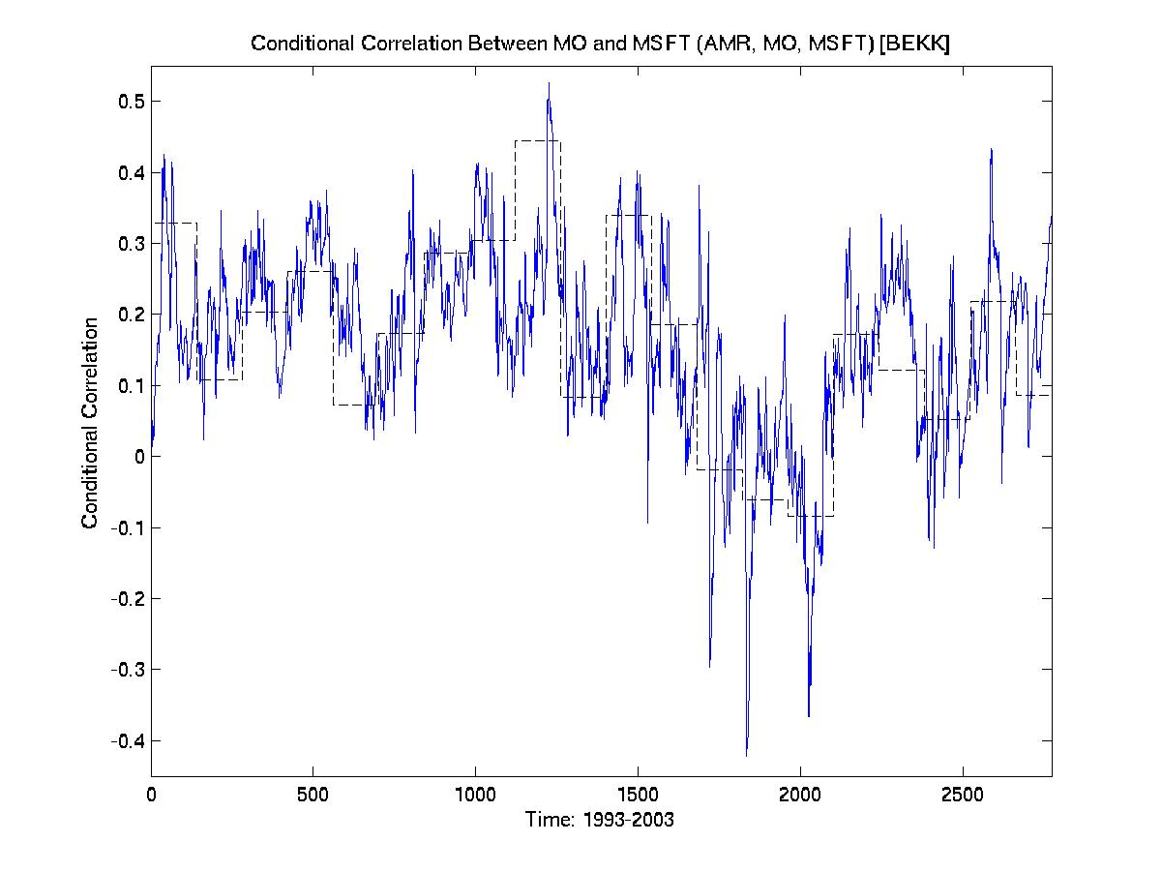
BEKK(1,1)
1993-2003 (daily)
with AMR, MO, MSFT

Slide 26
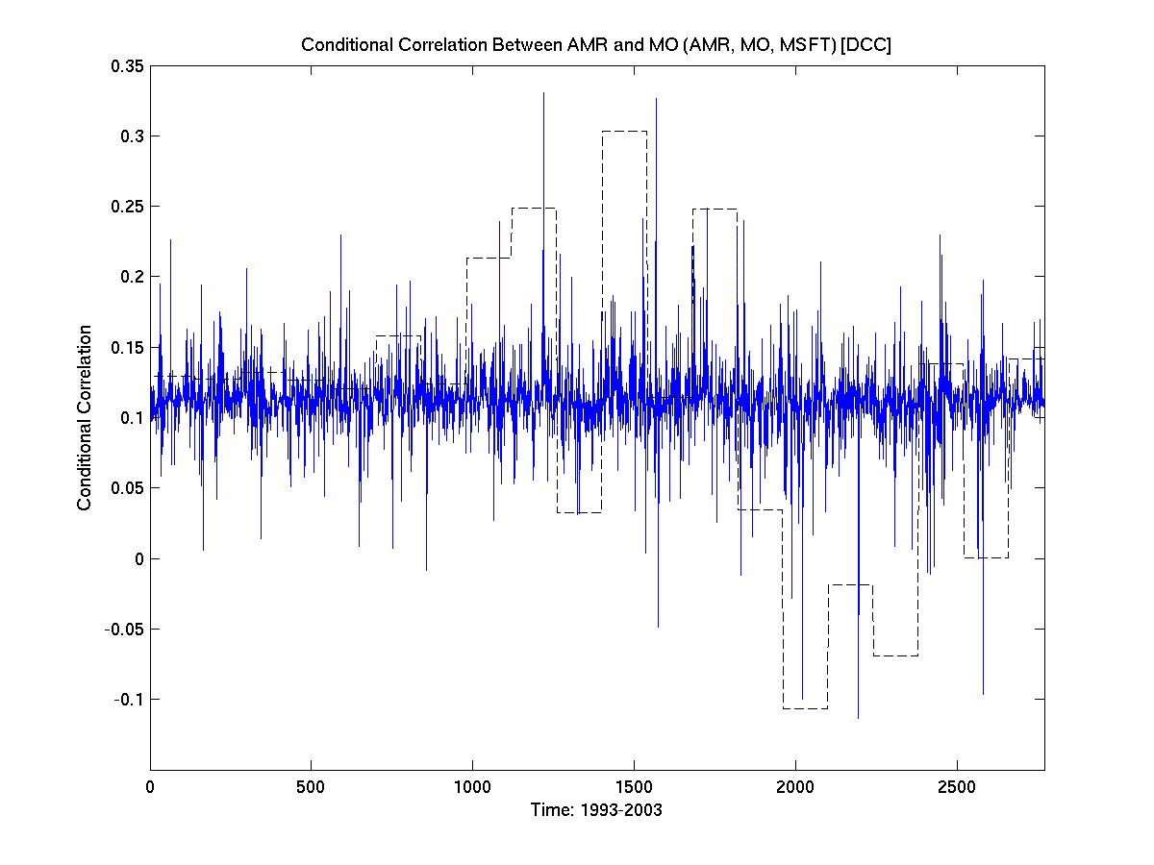
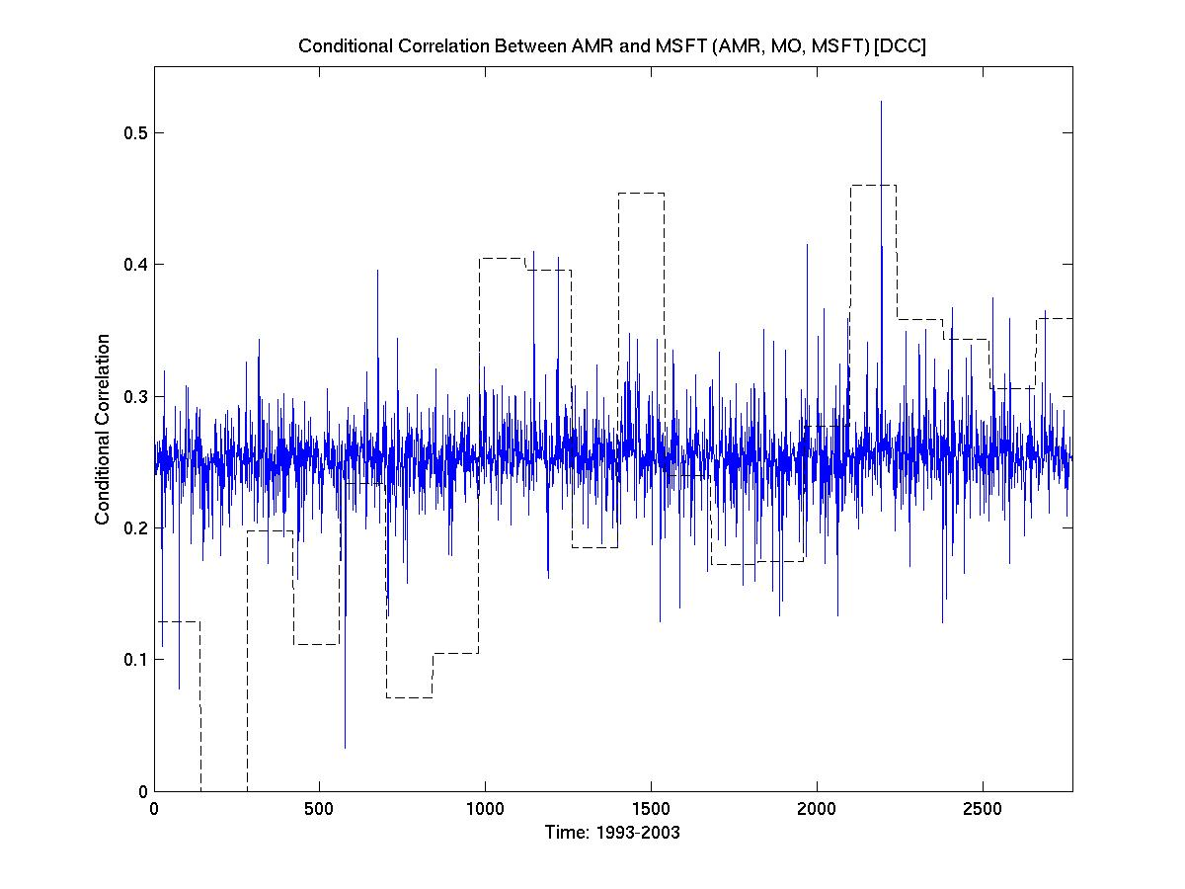
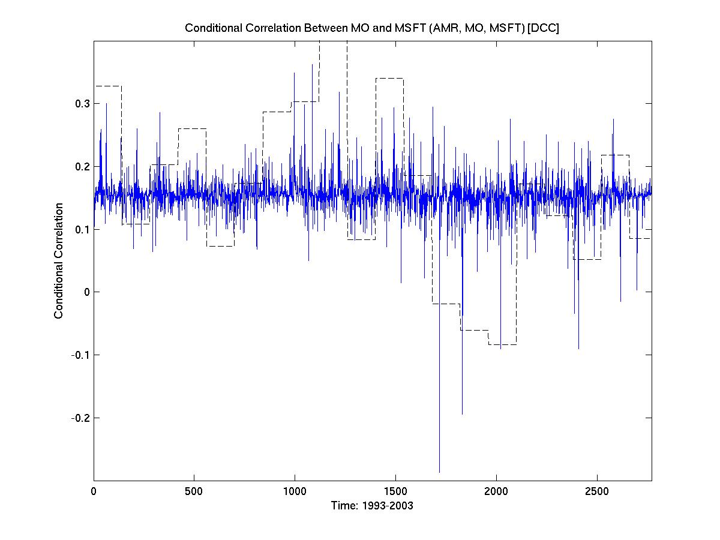
DCC(1,1)
1993-2003 (daily)
with AMR, MO, MSFT

Slide 27
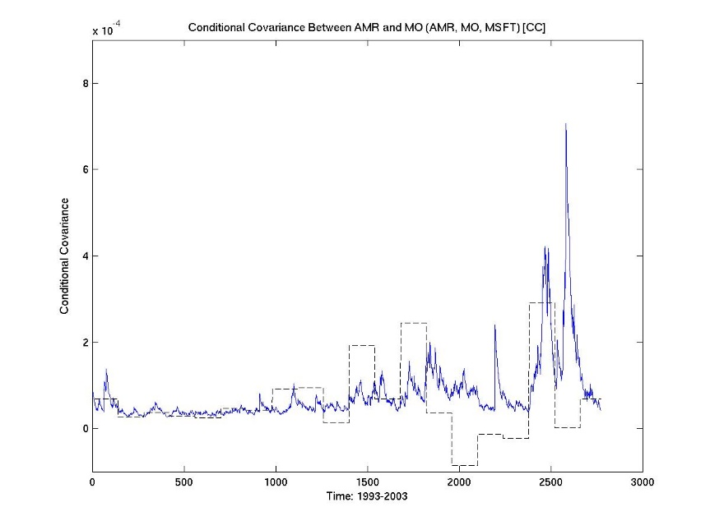
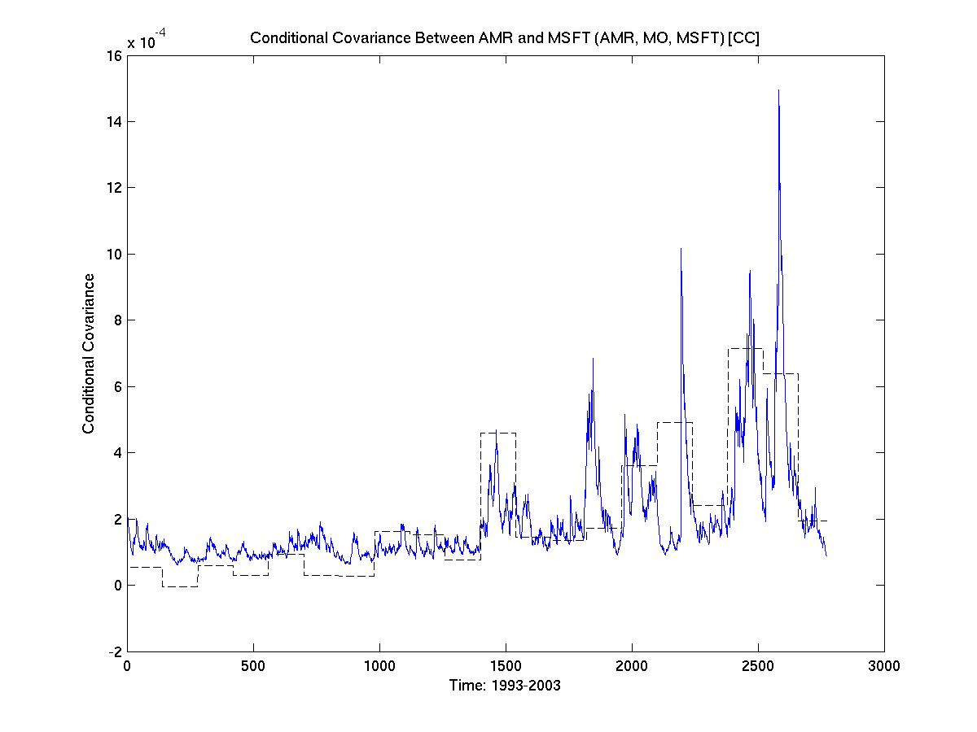
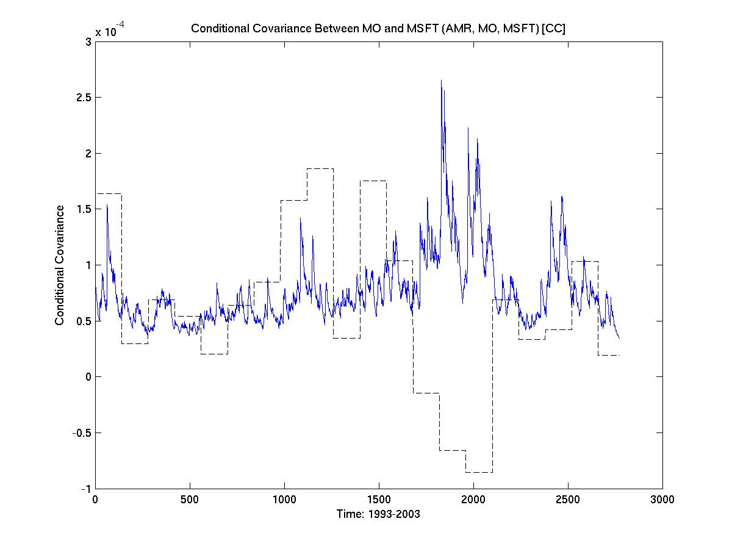
CC(1,1)
1993-2003 (daily)
with AMR, MO, MSFT

Slide 28
3 Stock Comparison
BEKK once again produces the best results
DCC performed worse than with 2 stocks
MO having too much influence?
Possible to handle stocks with low correlations at all?
Note: DCC seems to generally perform poorly with sets of any 3 stocks
CC performed similarly to the results with 2 stocks

Slide 29
Set of 4 stocks
AMR, MO, MSFT, and XOM
Transportation, Tobacco, Technology, and Oil
Predictions should improve
DCC to correct itself
Now that MO has less influence (?)
Now that there are more factors (?)

Slide 30
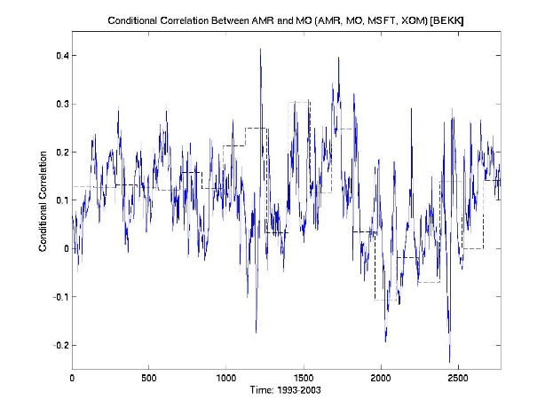
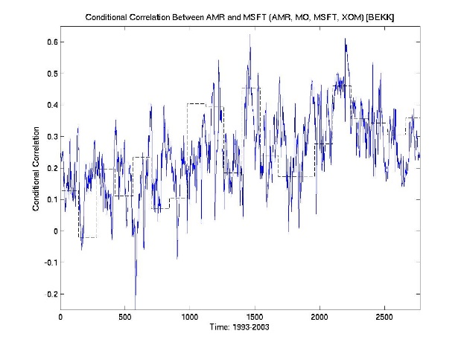
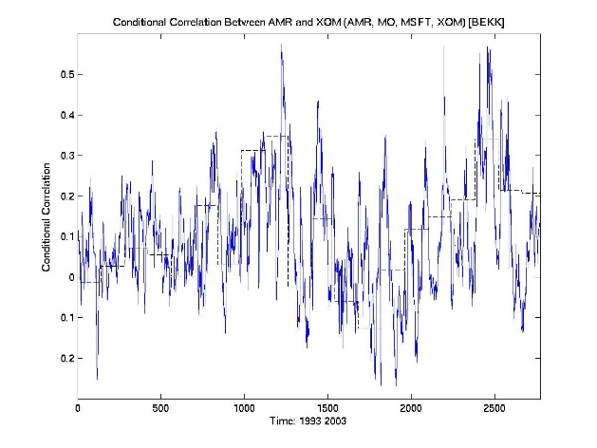
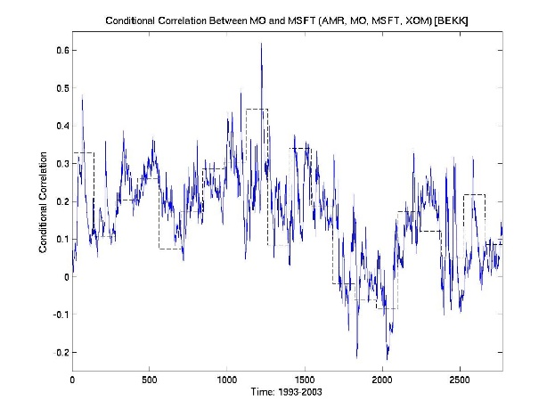
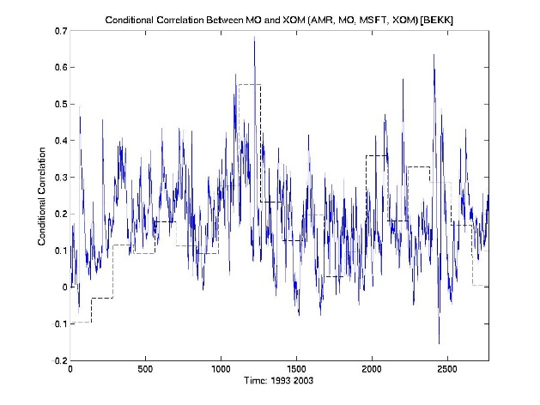
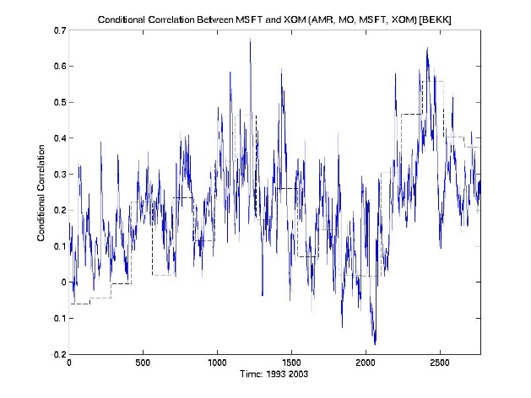
BEKK(1,1)
1993-2003 (daily)
with AMR, MO, MSFT, XOM

Slide 31
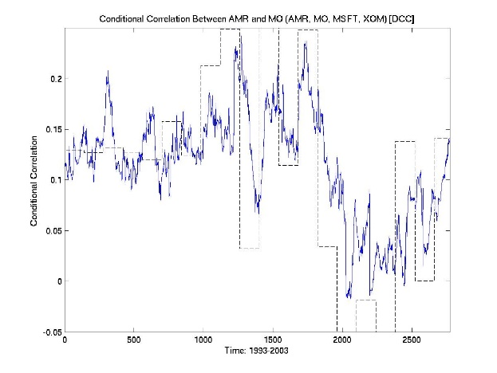
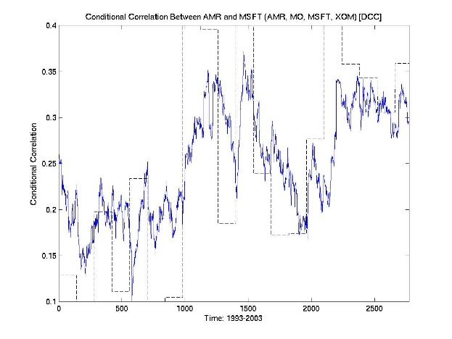
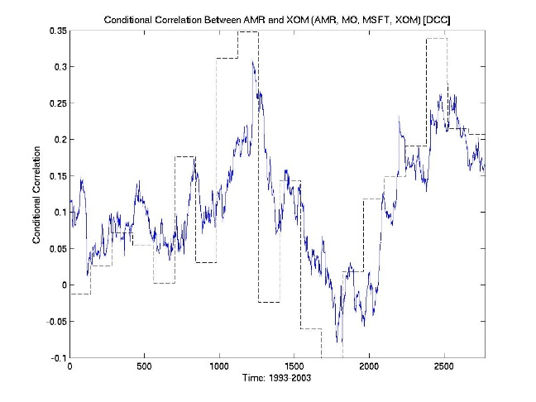
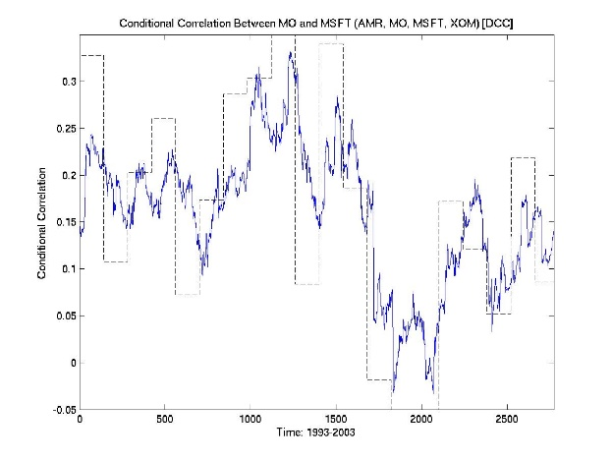
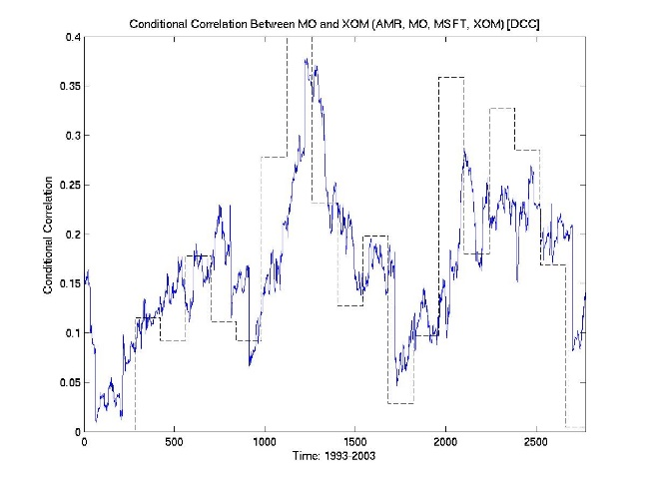
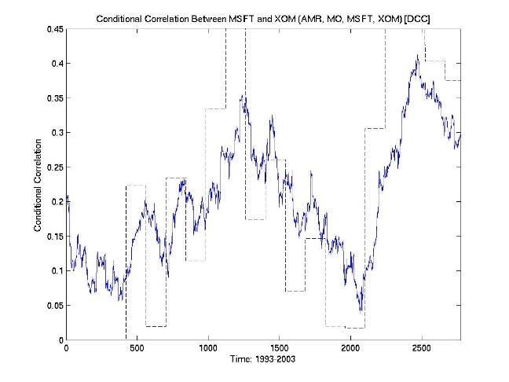
DCC(1,1)
1993-2003 (daily)
with AMR, MO, MSFT, XOM

Slide 32
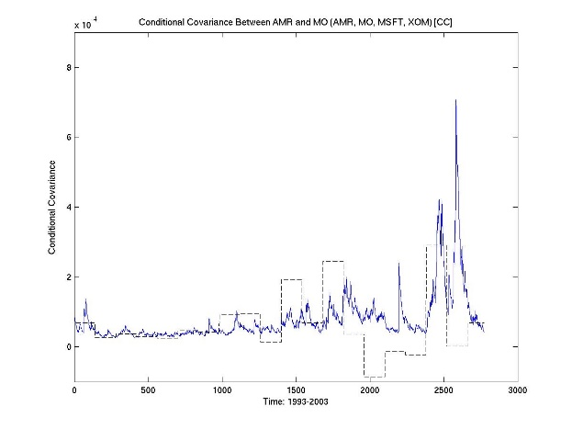

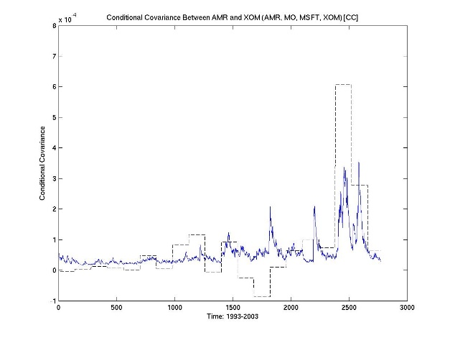
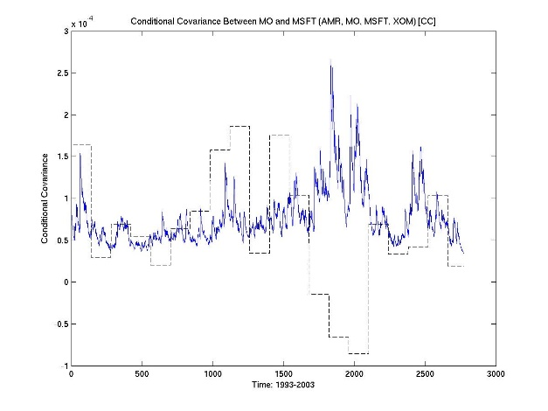
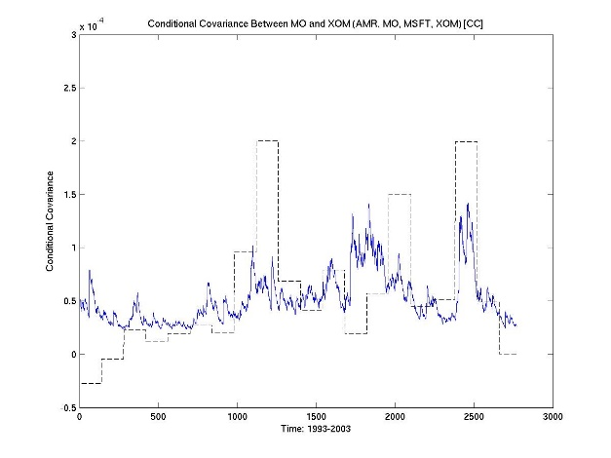
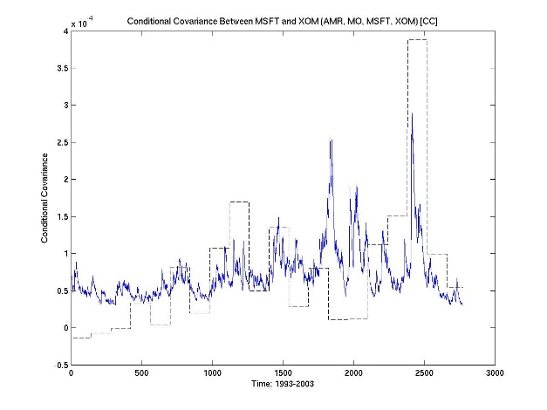
CC(1,1)
1993-2003 (daily)
with AMR, MO, MSFT, XOM

Slide 33
4 Stock Comparison
BEKK once again produces the best results
DCC improves significantly, almost as good as the BEKK
Lower lag than with 2 stocks
Handles low correlations (with MO)
CC performed similarly to the results with 2, 3 stocks

Slide 34
Conclusion
BEKK the best of the three models, but takes too long to run with multiple stocks
DCC’s performance approaches that of BEKK as the number of stocks increases, while it is significantly faster to run
CC performs consistently, however problems remain:
Constant correlation
Can’t handle negatives
Note: BEKK much ‘noisier’ than DCC

